Slide 1
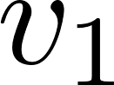
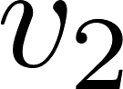


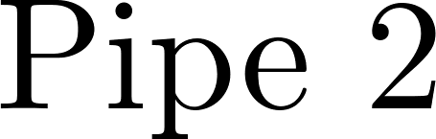
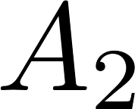

Slide 2
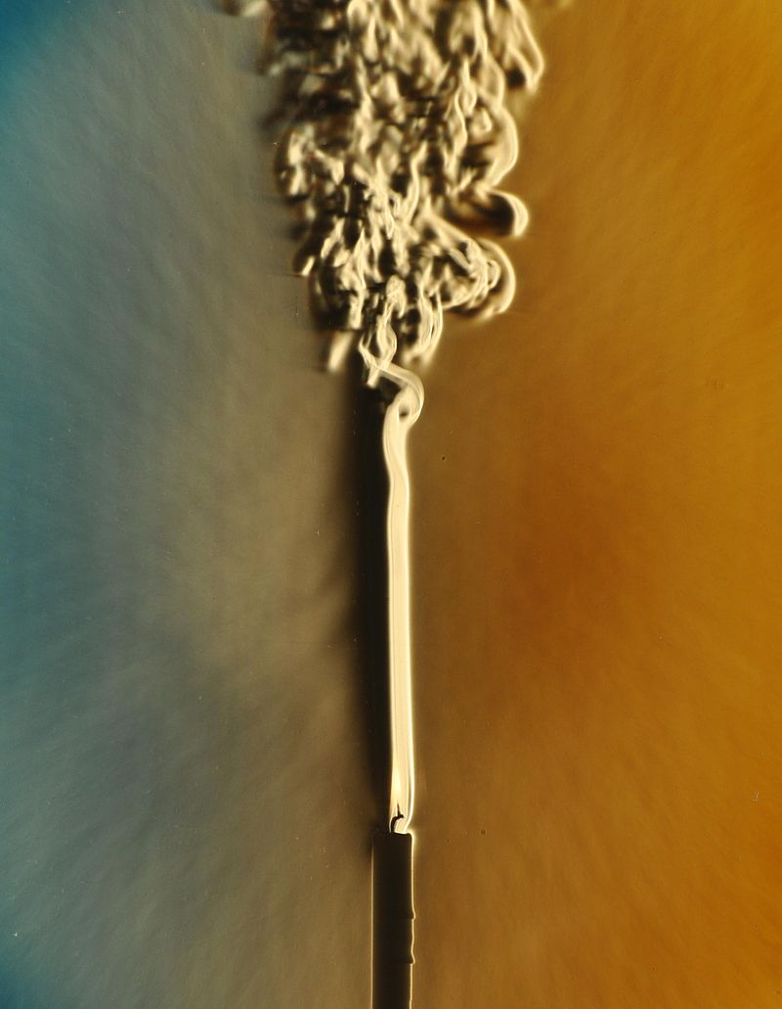



Slide 3
1 meter of elevation head
1 meter
Reference elevation
1 meter of pressure head
1 meter of velocity head

Slide 4

Solid red lines and points indicate streamlines
Dashed black lines indicate reference elevations
Dotted red lines indicate control volumes
A
B

Slide 5
v_{in}
v_{out}
A_{in}
x
A_{out}
in
out

Slide 6
C
B
A

Slide 7
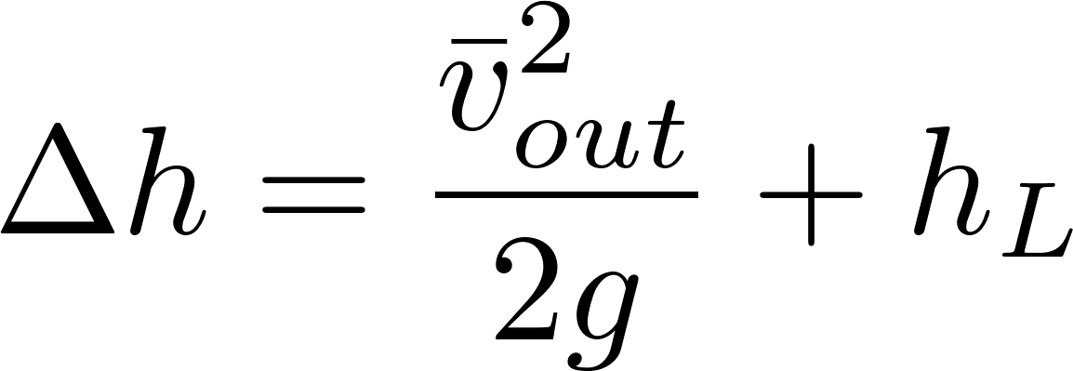
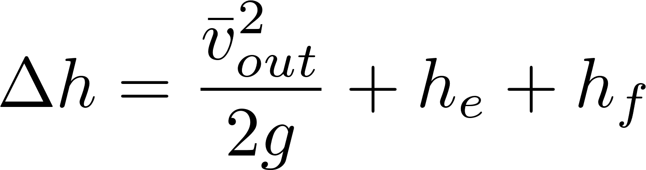
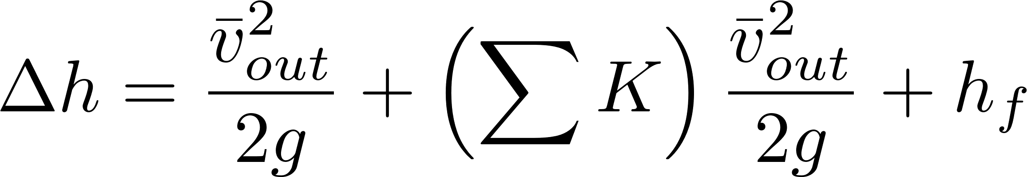

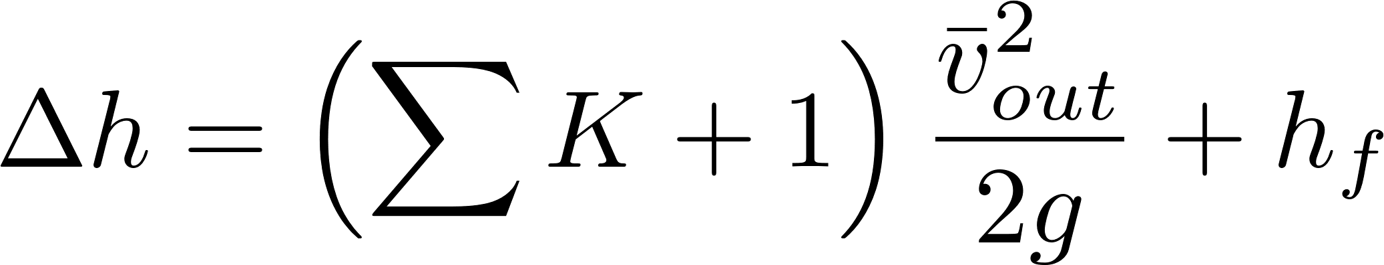
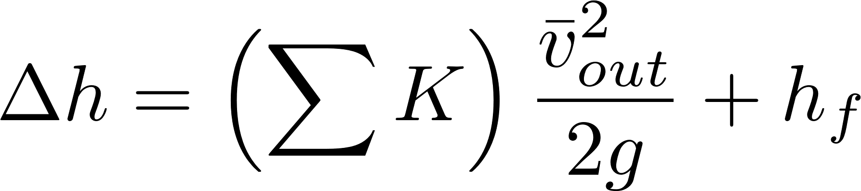
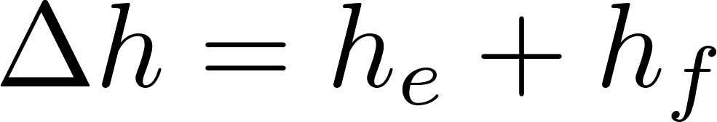

Simplified
energy equation
Small diameter tubing
Just adding
K = 1 to the sum

Slide 8




Slide 9
Horizontal orifice
Vertical orifice

Slide 10


A
B

Slide 11






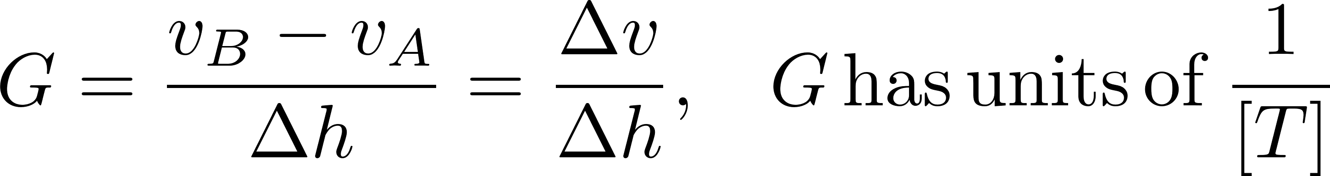

Slide 12


Slide 13
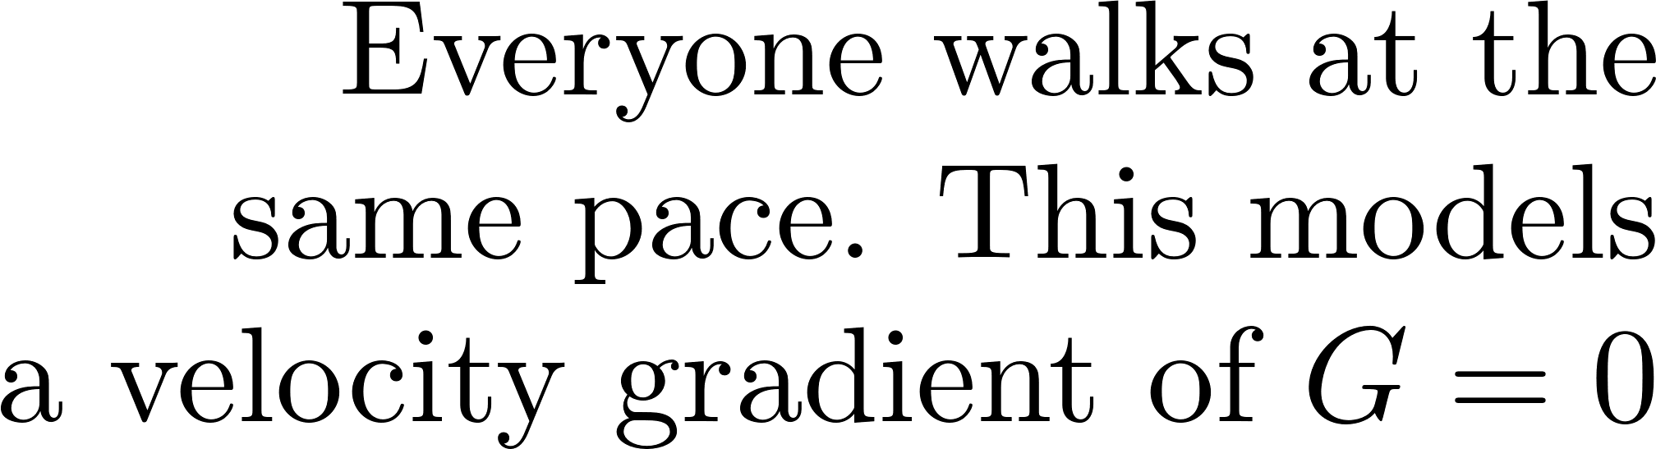

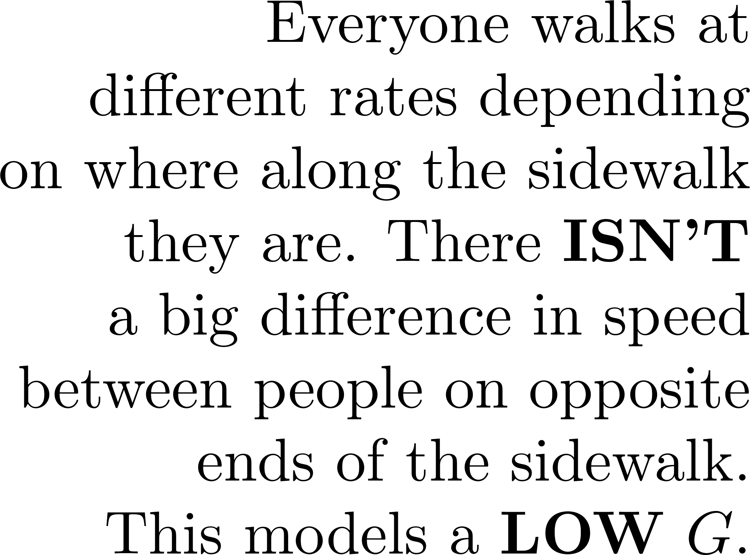
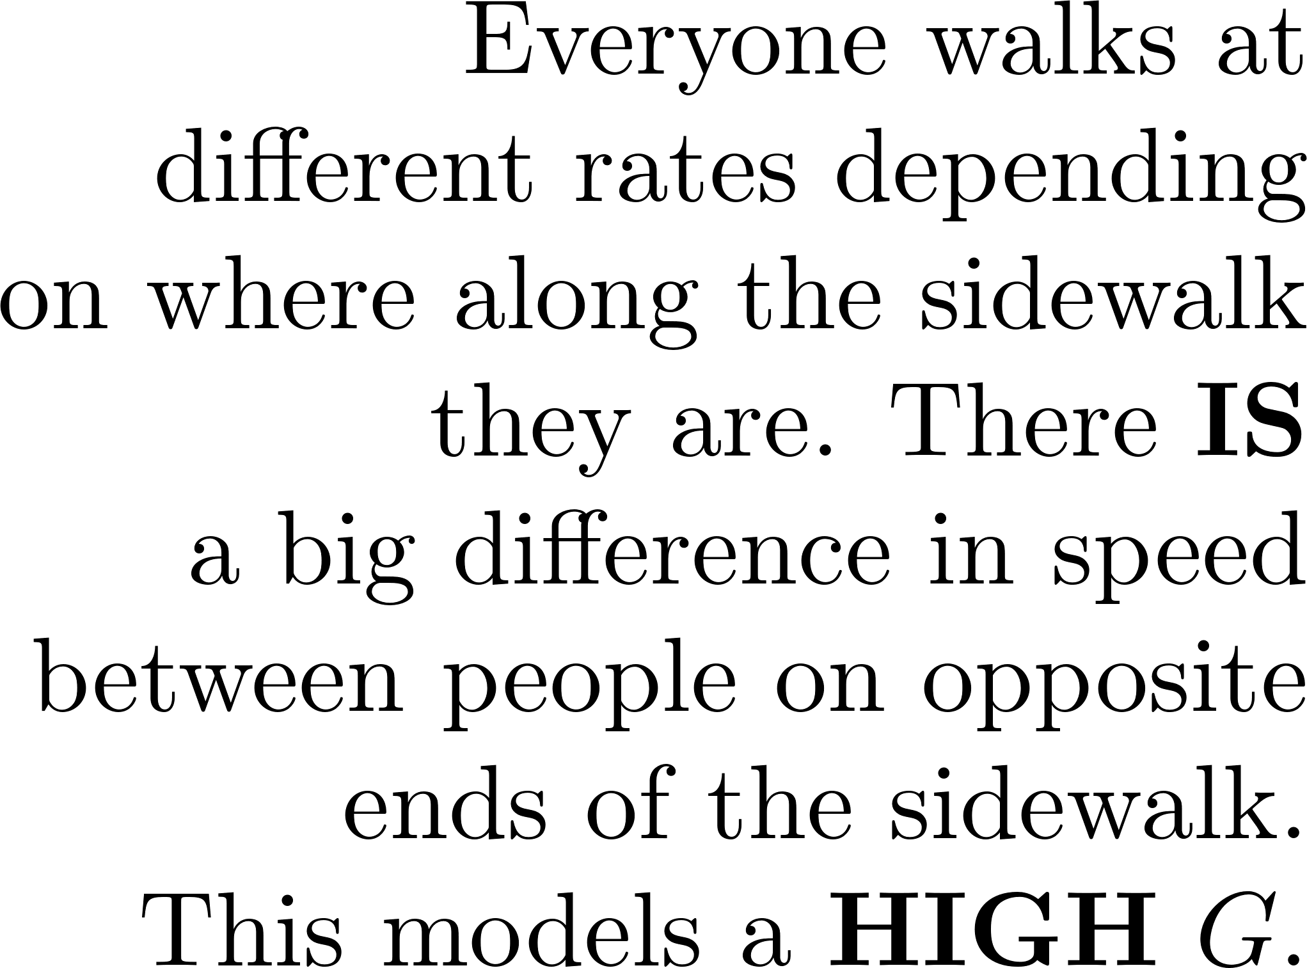
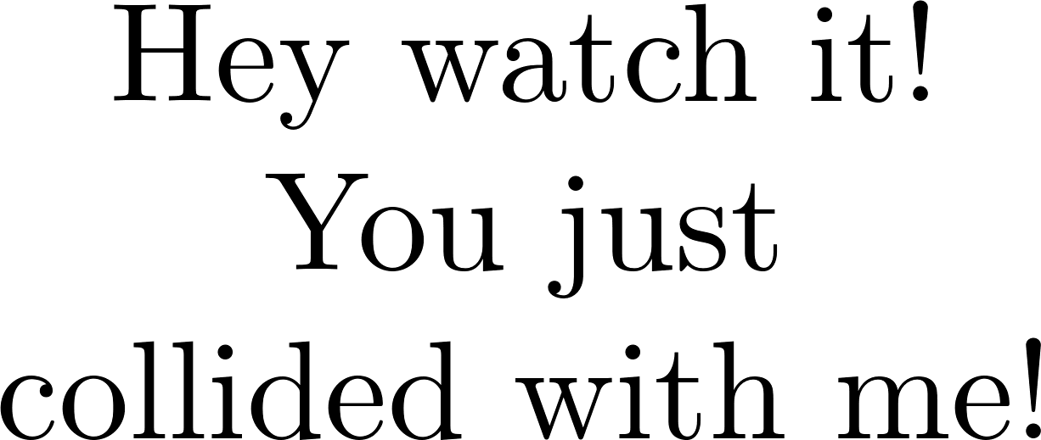

Slide 14



Tank
Valve
Water source pipe
Tank
Valve
Water source pipe

Slide 15
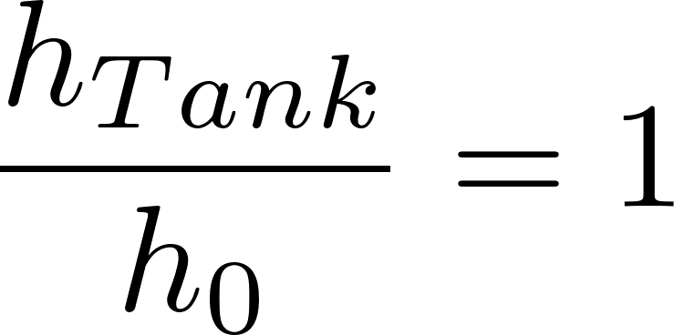
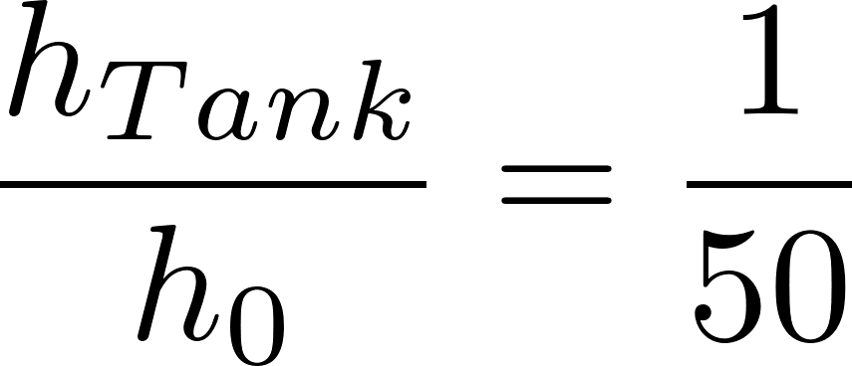
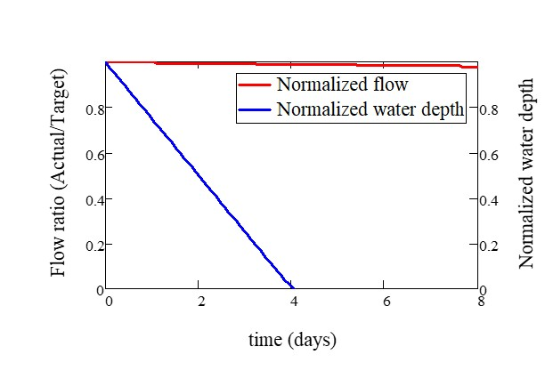
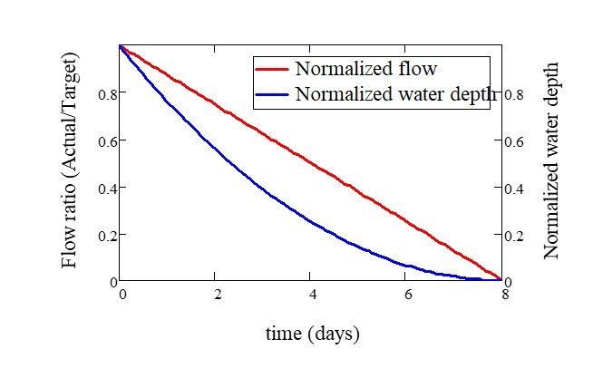

Slide 16
Pipe stub
Pipe coupling
Drain piping

Slide 17

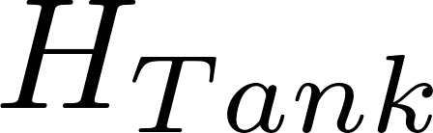
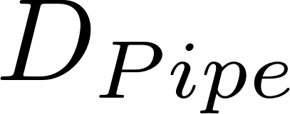

Slide 18
Float
Float
Orifice
Orifice
Transparent flexible tube
Transparent flexible tube

Slide 19
Overhead Tank
Constant head orifice
Overflow pipe
Pump

Slide 21
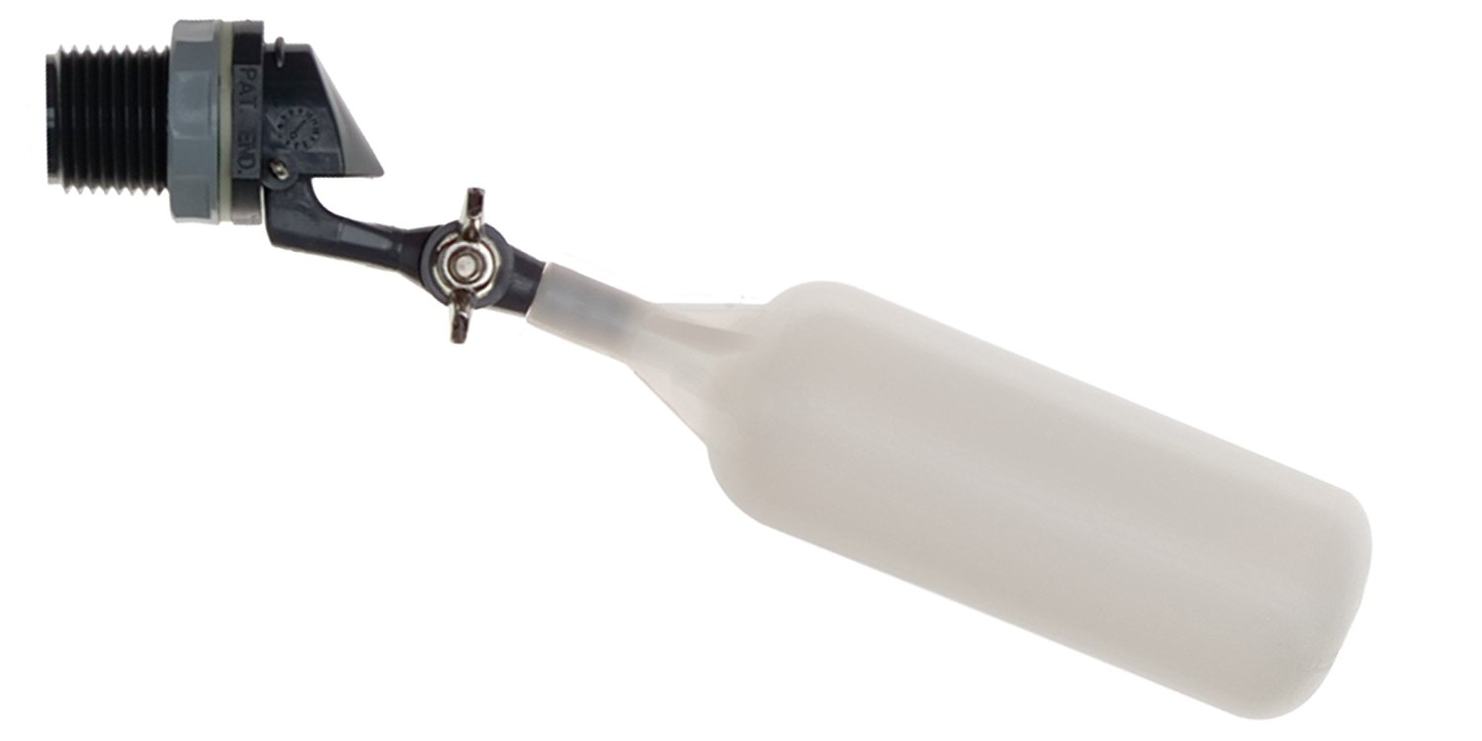
Flow of water
out of valve
Range of
motion of float
Float

Slide 22

Sutro Weir
LFOM

Slide 23


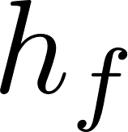
Air vent
Tube from the stock tank
Float valve
Holes to choose the dose
Flexible tube
Raw water
Rapid Mix
Orifice

Slide 24
Constant head tank
Stock Tank of coagulant
Float valve
Lever
Dose slider
Lever
counterweight
LFOM
Open channel supercritical flow
Float
Drop tube
Dosing tubes
Purge valves

Slide 25
Constant Head Tank (CHT)
Stock Tank of coagulant
Dosing tubes

Slide 26



Slide 27



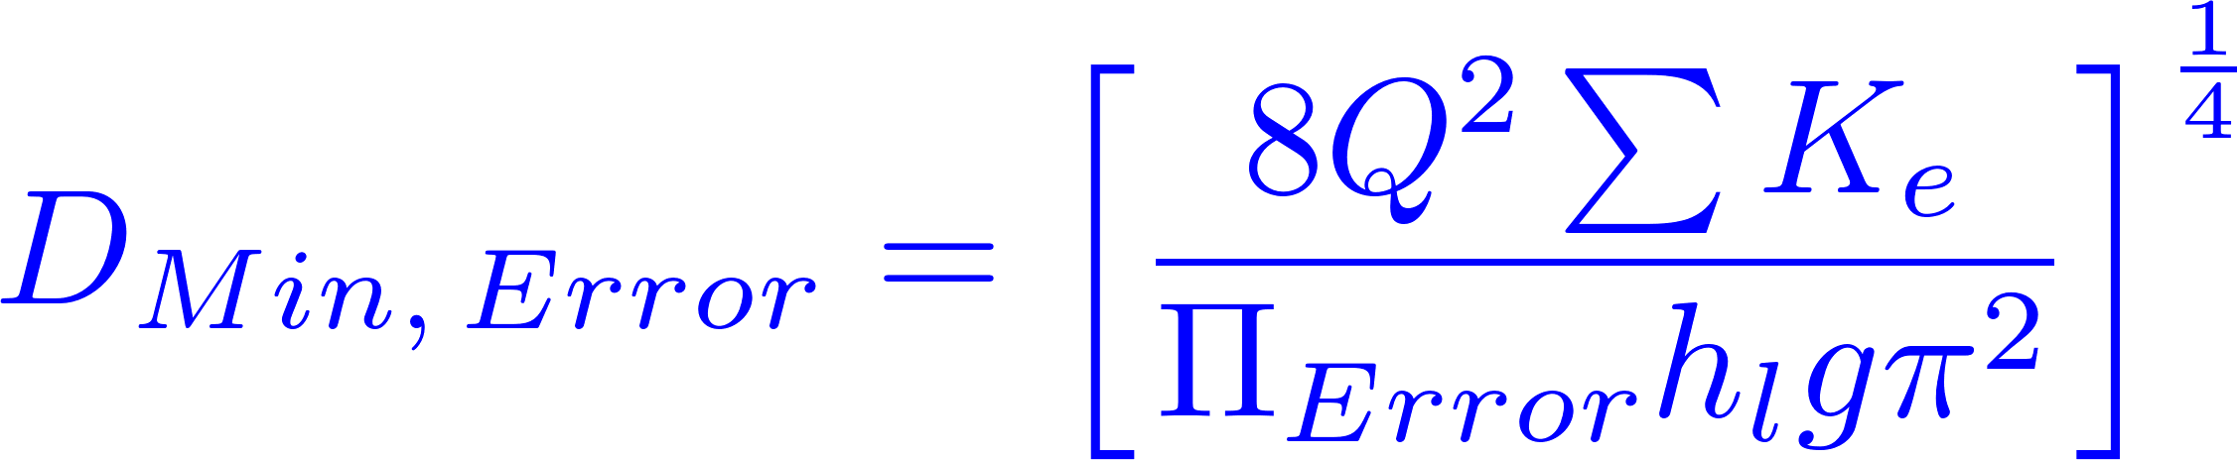



Slide 28



Calibrate at max flow

Slide 29

AutoCAD drawing of sedimentation tank, don’t worry if this is confusing!
You’ll learn about it in depth later on.
Sedimentation
tank drain

Slide 30
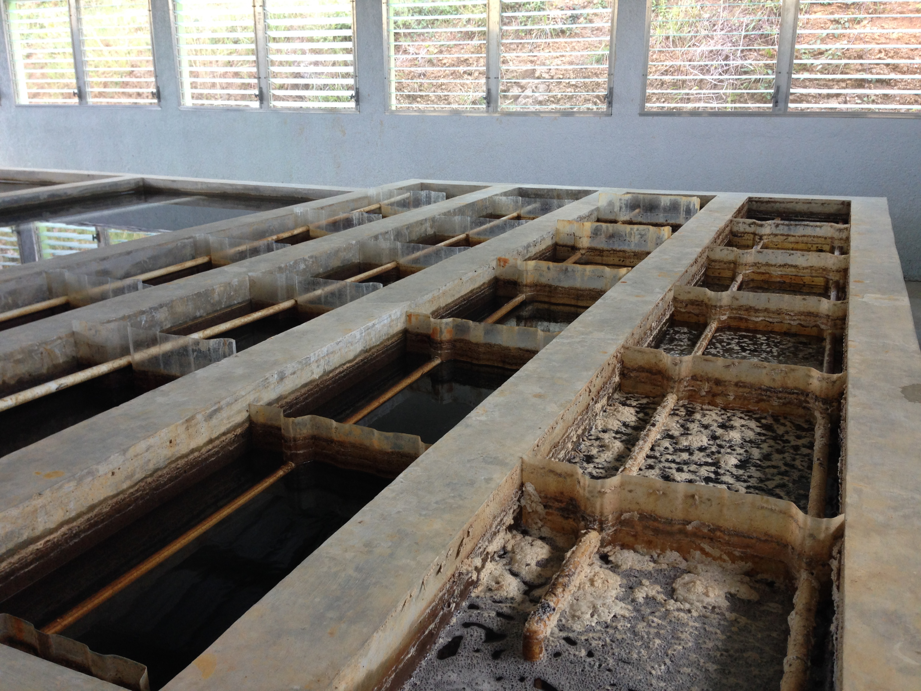
AguaClara Flocculator
Top Baffles
Bottom Baffles, underwater

Slide 31
AguaClara Flocculator

Slide 32
AguaClara Flocculator
Top and Bottom Baffles
Top Baffles
Bottom Baffles, underwater
Flocculator Channels
Flow Path

Slide 33









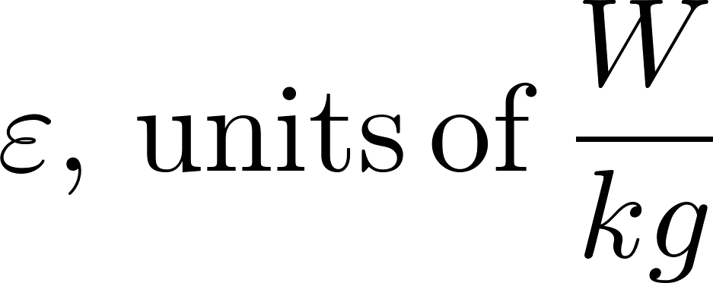

Dead Space,
lowers G

Slide 34


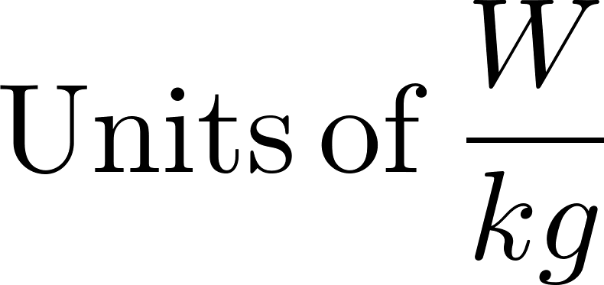

Slide 35
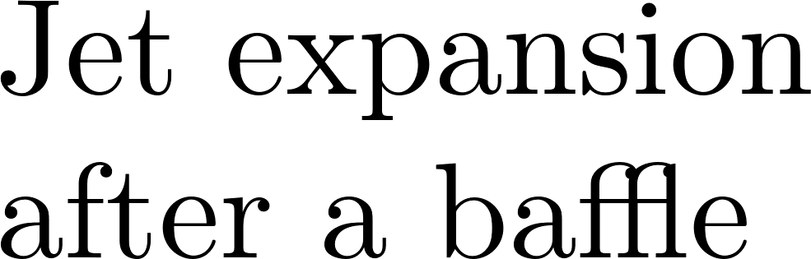


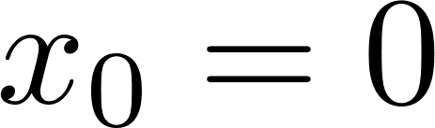
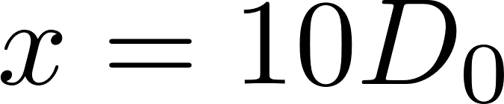

Slide 36





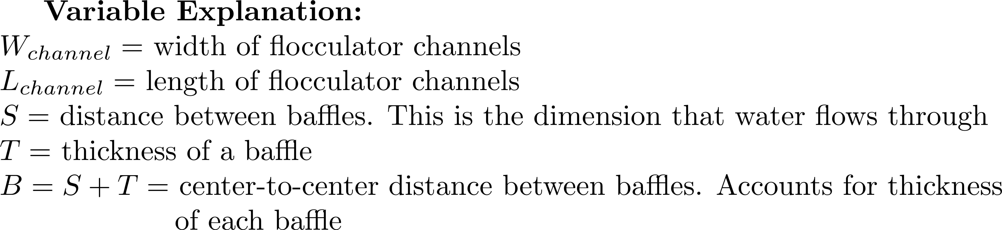
Top Baffles
Water
flow path
Side-view
Bottom Baffles
Plan-view

Slide 37
Top Baffles
Water
flow path
Vertical
Flocculator:
Side-view
The red lines represent
the most extreme
streamline for water
flowing around a baffle
Bottom Baffles
Plan-view

Slide 38
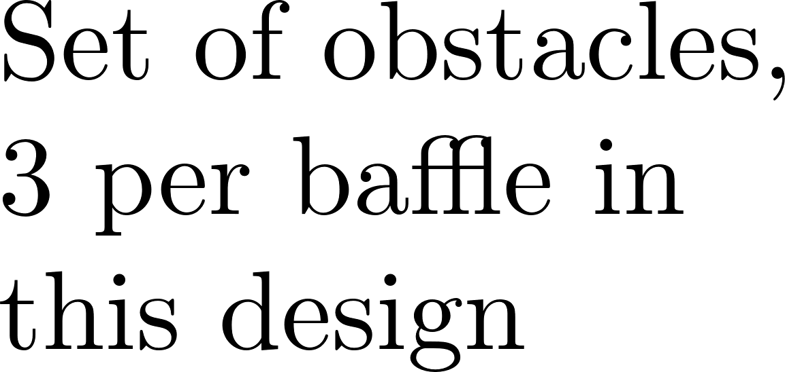





Slide 39

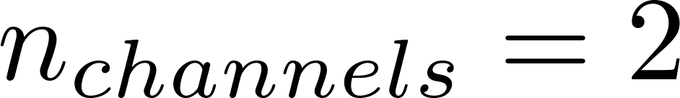
Flocculator
Channels
There are an even amount of flocculator channels to keep the AguaClara plant layout consistent. This ensures that the entrance tank, filter box, and filters can be kept in the same places across plants. Only for exceptionally low flow plants (< 5 LPS) is there one channel.

Slide 40

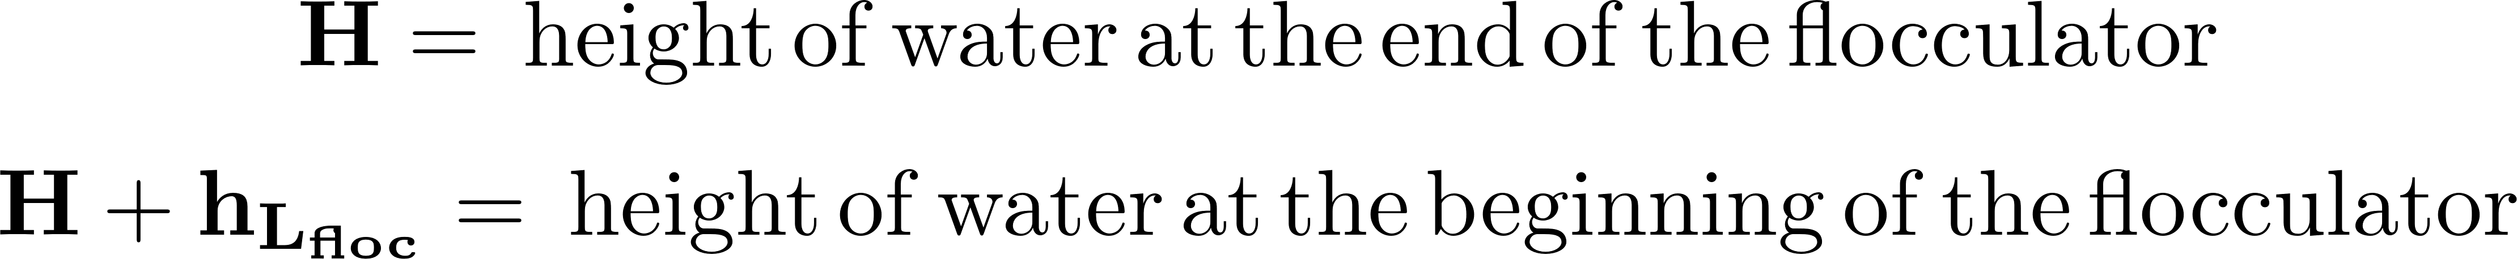
Sedimentation
Tanks (3)

Slide 41

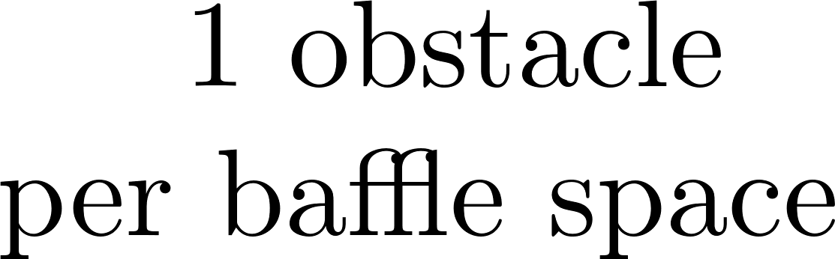
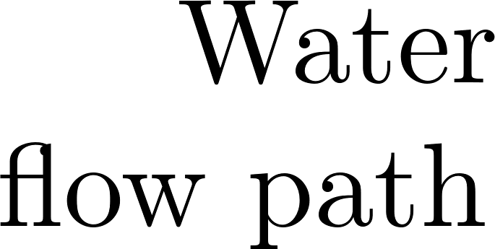




Slide 42
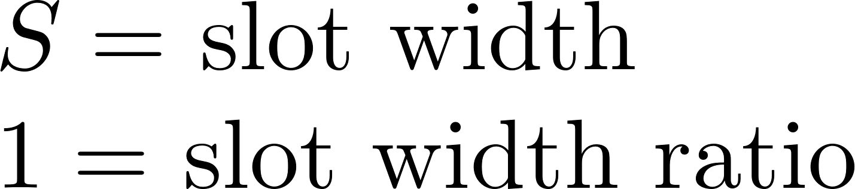

Slide 43
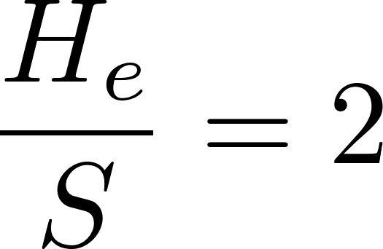
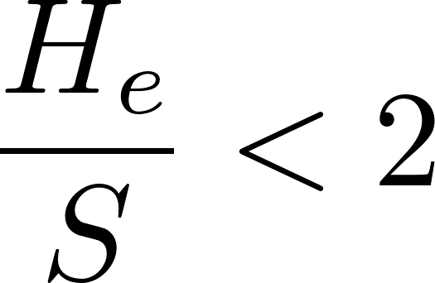
Dead Space
Dead Space

Slide 44

Area unaccounted for in the initial volume calculation. This makes θ_{actual} greater than the design θ. However, we do not believe that this extra ‘triangle’ of space has significant G values, and therefore we do not believe that it adds any collision potential to the design.
This image is just to show how water level decreases throughout a flocculator.
Standard AguaClara flocculators have at least two channels.

Slide 45
